Slide 1
Date: 18 November 2025

Slide 2
Weekly Presentation : Rotor Bearing System
Week number: 08
Date: 18 /11/2025
Supervisor: Prof. Peter Quell
Group members: Divyesh Mistry, Venkata Sreekanth .K , Sreehari Padachery, Jill Sadariya
Presenter : Jill Sadariya

Slide 3
Agenda
Bolted Flange Calculation –Hub side.
Flange Screw dimension Calculation.
Hydraulic Torqure wrench for M36 bolts.
Bolted Flange Calculation –Gear box side.
Rotor Lock Pin Calculations.
CAD Model of Spherical roller Bearing.
Bibliography.

Slide 4
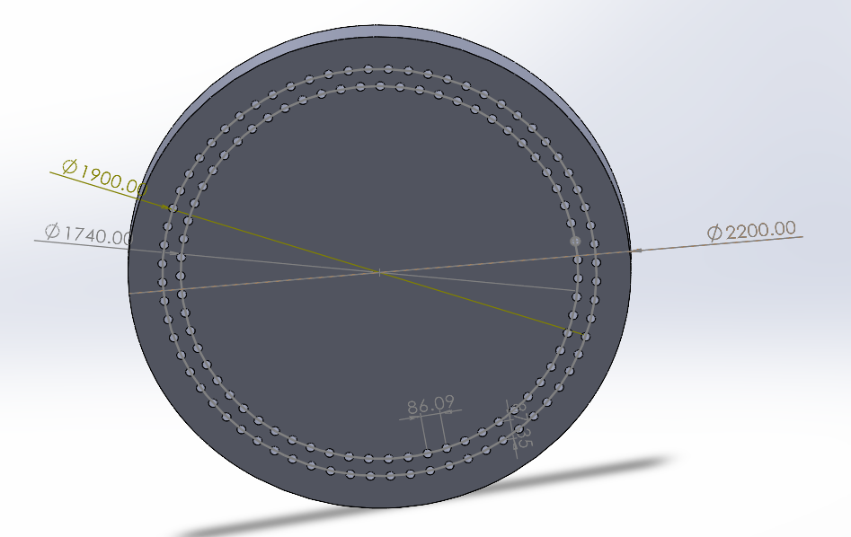
Bolted Flange Calculation –Hub side without Rotor lock consideration
Description | Symbol | Value | Unit
Outer screw circle diameter | dt1 | 1900 | mm
Inner screw circle diameter | dt2 | 1740 | mm
No. of screws per bolt circle diameter | N_{total} = N_{ICB} + N_{OCB} | 63+68=131
Total tensile force on flange | F_{a,F,ges} | 633.7 | kN
Lateral force on flange | F_{q,F,ges} | 1810.5 | kN
Torsional moment on flange | M_{t} | 2747.0 | kN.m
Bending moment on flange | M_{B} | 21573.8 | kN.m
Hole dia = 39 mm (36+3mm) e
*F &M are scaled up from Shakti
Source: Optimus Shakti

Slide 5
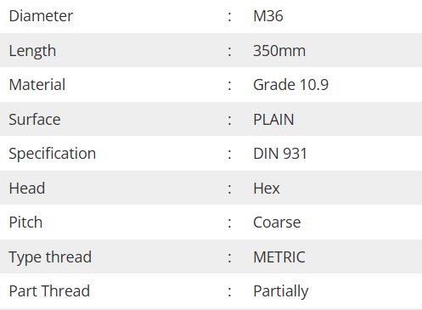
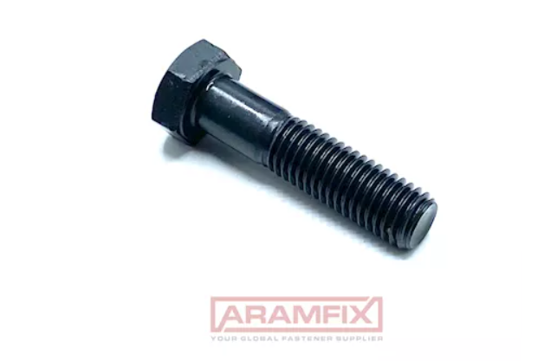
Flange Screw dimension Calculation
Source:ARAMFIX

Slide 6
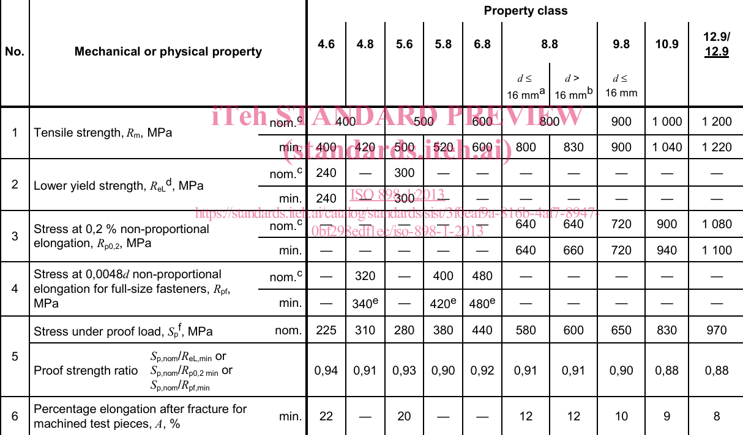
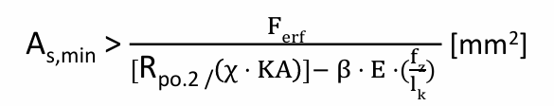
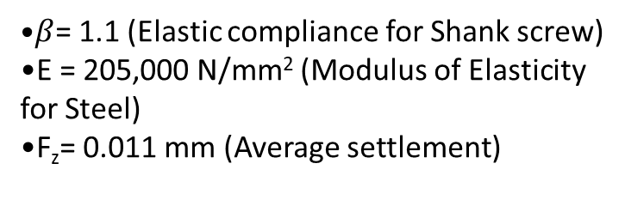
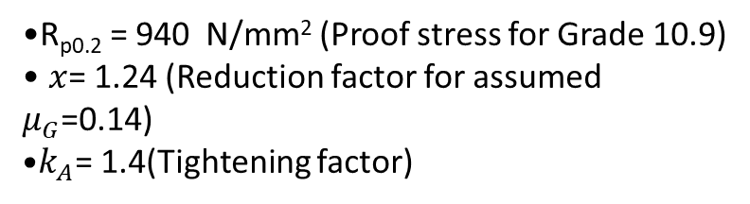
Flange Screw dimension Calculation
Roloff-Matek (RM) equat. 8.2
R_{p0.2} = 940 N/mm² (Proof stress for Grade 10.9)
$x$= 1.24 (Reduction factor for assumed $μ_{G}$=0.14)
$k_{A}$= 1.4(Tightening factor)
$β$= 1.1 (Elastic compliance for Shank screw)
E = 205,000 N/mm² (Modulus of Elasticity for Steel)
F_{z}= 0.011 mm (Average settlement)

Slide 7
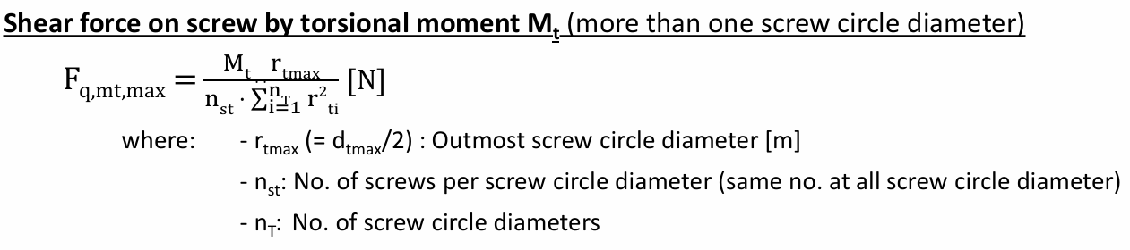
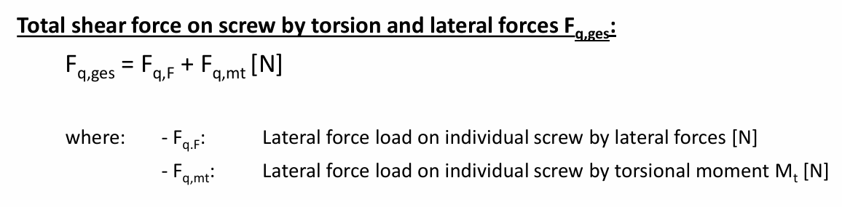
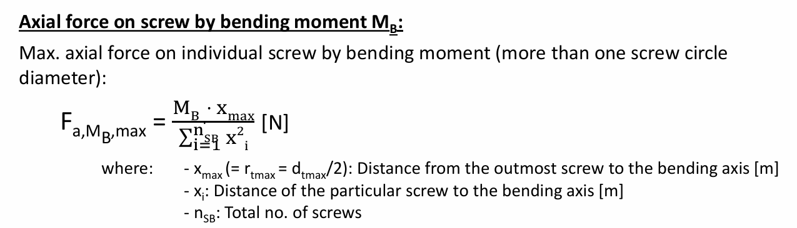



Flange Screw dimension Calculation
Max Axial Force from Bending Moment (Multi-Circle)
Axial Force from Thrust/Tensile Load
Ferf = Fa,ges + Fkl
Requird total axial force of the screw Ferf
7

Slide 8
Flange Screw dimension Calculation
Description | Value | Unit
Shear force on screw by external lateral force | 13.821 | KN
Shear force on screw by torsional moment F_{q, mt, max} | 23.931 | KN
Total shear force on screw by torsion and lateral forces F_{q, ges} | 37.752 | KN
Axial force on screw by thrust or tensile force | 4.837 | KN
Axial force on screw by bending moment M_{b} | 187.970 | KN
Total axial force on screw F_{a, ges} | 192.807 | KN
Required force of individual screw F_{kl} | 125.840 | KN
Required total axial forceF_{erf} | 318.647 | KN
A_{S,min}> F_{erf}/ (R_{p0.2} *0.9) | 376.16 | mm²

Slide 9
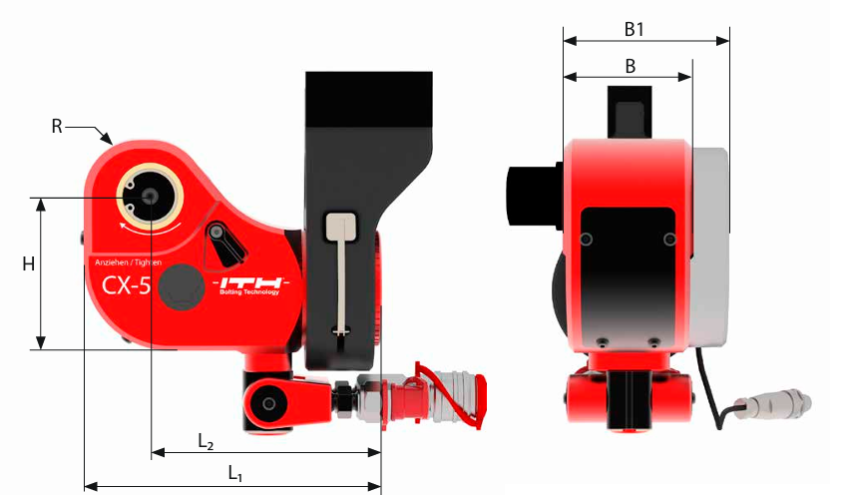
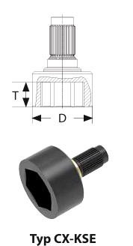
Hydraulic Torqure wrench for M36 bolts
D-87
Diameter of the socket at hexagonal head side of the Bolt
ITH Type- CX 5
Source: ITH

Slide 10
Bolted Flange Calculation –Gear box side
Description | Symbol | Value | Unit
Flange Outer Diameter | d | 1576 | mm
Pitch Circle Diameter | D_{PCD} | 1376 | mm
Maximum Number of Holes (N) | N_{total} | 49
Minimum Center-to-Center Pitch | P_{req} | 87 | mm
Hole dia = 39 mm (36+3mm) e

Slide 11



Rotor Lock pin Calculations
$\text{F} \text{=}\frac{\text{M}T}{\text{2∗}\text{r}}$
where, Lock pin hole circle radius r = 1425mm
Torsional moment scaled from shakti Mt= 2747.45 KNm
Doubt
Torsional moment (considering 250% of the calculated value), same 250% percentage used in Optimus Shakti and Optimus 60E
Torsional moment Mt= 6868.25 KNm
$\text{F} \text{=2410.04}\text{kN}$
Thickness of Integrated rotor lock disc = Flange thickness+thickness of disc= 150+100=250mm
Bending Moment acting on the Lock pin ,M_{bpin=}F*L
M_{bpin=}2410.04*135 =325355.4KN.mm
pressure acting on the hole of the disk ,P= F/A
P= 479.6 N/mm²
The disk hole = Diameter of lock pin +3mm = 198+3= 201 mm
Pressure acting area of the hole, A=201*135=5025 mm2

Slide 12


Rotor Lock pin Calculations
Allowable bending stress of the material 42CrMO4 = 0.66fy Where Yield strength of the material 42CrMO4 , fy = 650 MPa or 650 N/mm2
Allowable bending stress of the material 42CrMO4 = 0.66 × 650 N/mm2
Allowable bending stress, σ = 429 N/mm2
Allowable bending stress of 42CrMO4 is more than the Pressure acting on the hole of the disc.
$\text{σ} \text{=}\frac{\text{M} \text{b}\text{,}\text{pin}}{\text{W}}$
Allowable bending stress
$\text{W}\text{=}\frac{\text{π}\text{ × }\text{d}\text{3}}{\text{32}}$
L2= 35mm
L2
The diameter of the Lock pin, d1 = 198mm
D2=82mm
D1
D2
D1=198mm
The disk hole = Diameter of lock pin +3mm = 198+3= 201 mm
The Length of Lock pin L1 = 365mm (Assumed same as Optimus Shakti)
L1

Slide 13
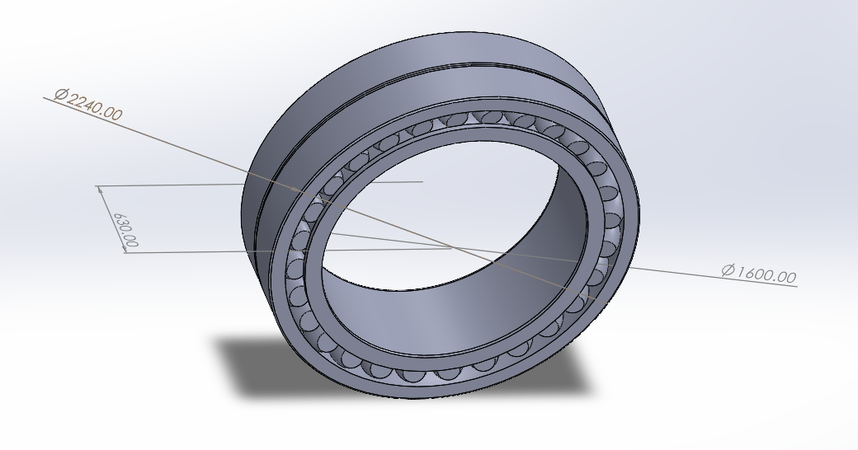
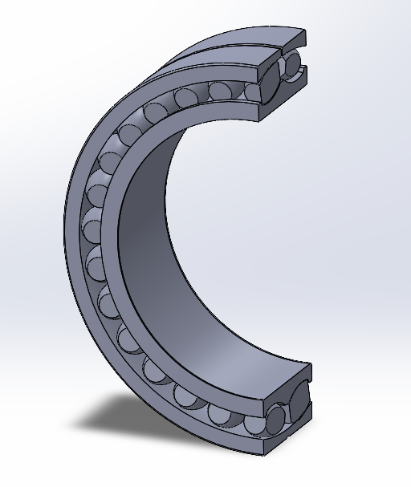
240/1600 CAF/W33 Spherical roller bearing CAD Scaled Model

Slide 14
Bearing Dimensions
Parameter | Symbol | Scaled × 1.4286 (1600 bore)
Bore diameter | d | 1600 mm
Outer diameter | D | 2240
Total width | B | 630 mm
Rollers per row | n | 28
Roller diameter | Dᵣ | 132.86 mm
Roller length | Lᵣ | 249 mm
W33 groove width |  | 17 mm
Materials |  | Bearing steel / brass (CA)
The scaled bearing size closely matches the specification mentioned in the SKF email communication regarding the outer diameter and width.

Slide 15
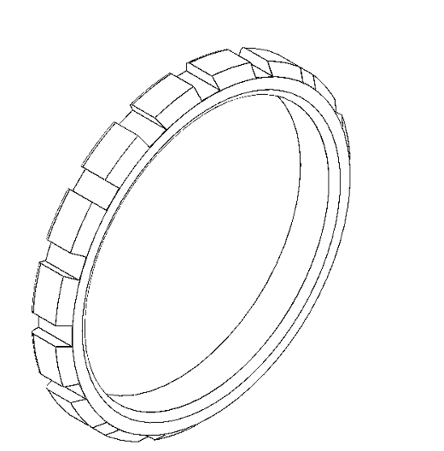
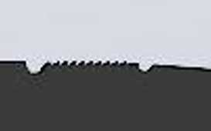
Lock Nut
Tr 1600*24
Nominal Thread depth = .5*24 =12
Assumed scaled up value based on Optimus Shakti and Optimus 60E
Source: Optimus 60E

Slide 16
Bibliography – Rotor Bearing System
SKF. (n.d.). 240/1120 CAF/W33 - Spherical roller bearings. Retrieved October 29, 2025, from https://www.skf.com/group/products/rolling-bearings/roller-bearings/spherical-roller-bearings/productid-240%2F1120 CAF%2FW33
Optimus Shakti, Optimus 60E
ITH. (n.d.). ITH Hydraulic Torque Wrenches Catalog. Retrieved November 08, 2025, from www.ITH.de/schraubwerkzeuge/hydraulische-drehmomentschrauber
Aramfix. (n.d.). DIN 931 Hex Bolt M36x350mm Grade 10.9 Plain Metric Partially Hex. Retrieved November 17, 2025, from www.aramfix.com/product/din-931-hex-bolt-m36x350mm-grade-10-9-plain-metric-partially-hex-5-pcs-box

